Slide 1
Customer Segmentation
By Stephen Fortin, MBA

Slide 2
Agenda
To discuss the following with regards to the current project:
Background and rational
Exploratory data analyses
Analyses and results
Discussion and conclusions

Slide 3
Background and Rational

Slide 4
Background
Based on a problem posted on Kaggle:
Link: https://www.kaggle.com/datasets/vjchoudhary7/customer-segmentation-tutorial-in-python/data
Through membership cards, you have collected basic data on customers at your mall:
Customer ID
Age
Gender
Annual Income
Spending Score: calculated and assigned to customers based on their behavior and purchasing data

Slide 5
Objective
Primary Objective: To identify customer segments from the data.
The customer segments identified will ultimately be provided to the marketing team, and may be utilized for a variety of potential purposes:
Identification of high-value customers for targeted ad campaigns
Enhancement of customer satisfaction and engagement with more personalized ad campaigns
Tailor marketing strategy to optimize return on investment (ROI) of ad spend
Improve customer retention by addressing the needs of customer segments

Slide 6
Exploratory Data Analysis

Slide 7
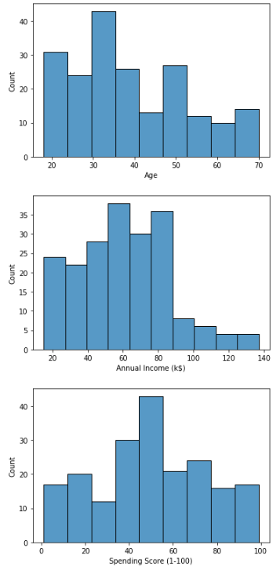
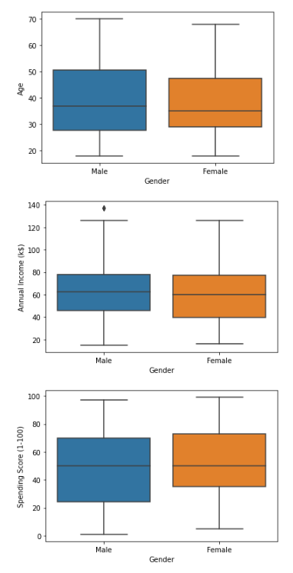
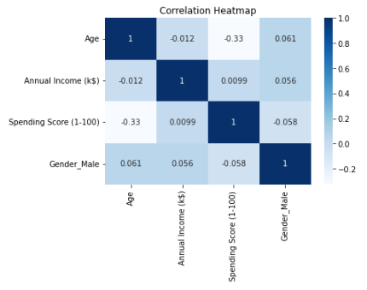
Descriptive Analyses
200 rows
200 customers
5 columns
4 features (excluding Customer ID)

Slide 8
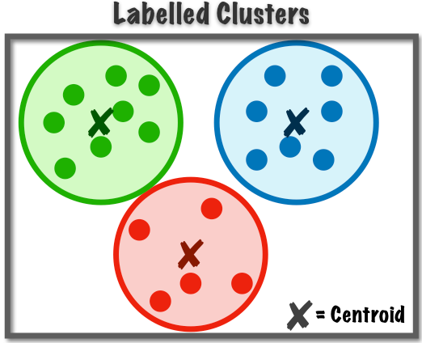
Data Preprocessing
Drop Customer ID column
Unique customer identifier
Not a feature
One-hot encoding binary variable
Gender
Standardize continuous variables
Age, annual income, spending score
Important for distance-based clustering methods such as K-means clustering

Slide 9
Analyses and Results

Slide 10
Unsupervised Learning Algorithms
We tested the performance of following unsupervised learning algorithms:
K-mean clustering
Hierarchical clustering
DBSCAN clustering

Slide 11
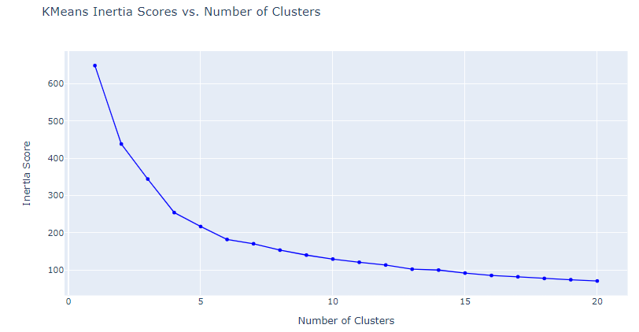
K-Means Clustering
Use all 4 features from dataset
Elbow Method used to select the optimal number of clusters
Elbow appears to be present in the figure (right) at approximately k=6
Number of clusters was set to 6
Silhouette Score used to evaluate fit
Value of 0.62
Good score, represents “reasonable” fit

Slide 12
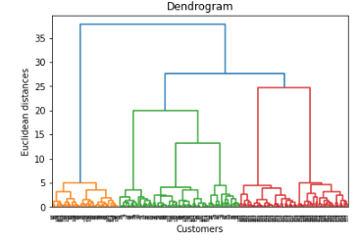
Hierarchical Clustering
Use all 4 features from dataset
Parameters/Hyperparameters:
Agglomerative clustering
Number of clusters = 6
Affinity = ‘eucladian’
Linkage = ‘ward’
Silhouette Score used to evaluate fit
Value of 0.62
Good score, represents “reasonable” fit
Same clusters identified as compared to K-means clustering

Slide 13
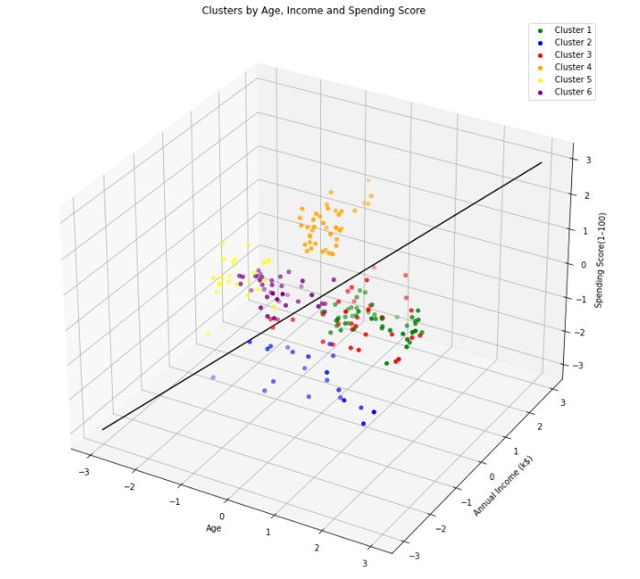
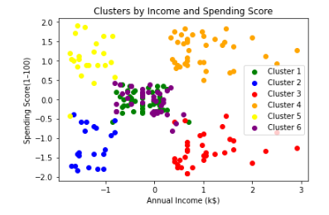
K-Means / Hierarchical Clusters
3-Dimensional
2-Dimensional

Slide 14
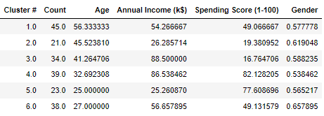
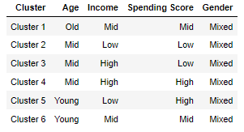
K-Means / Hierarchical Clusters
Mean and Proportion of Features Across Clusters
Qualitative Description of Clusters

Slide 15
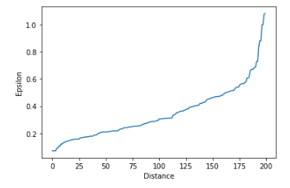
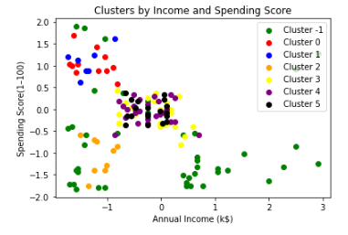
DBSCAN Clustering
Use all 4 features from dataset
Elbow Method used to select the optimal epsilon
Elbow appears to be present in the figure (right) at approximately epsilon = 0.7
Min_samples hyperparameter set to 5
Silhouette Score used to evaluate fit
Value of 0.18
Represents very weak fit
Experimented with Epsilon scores 0.6-0.8 and min_samples 5 to 10 → little improvement

Slide 16
Discussion and Conclusion

Slide 17
Conclusion
K-means and Hierarchical Clustering outperformed DBSCAN Clustering
Identified a total of 6 customer segments from clustering algorithms
Clusters with a high Spending Score were comprised of:
Young, low-income customers
Middle-aged (early 30s), high-income customers
May represent high value customers
Clusters comprised of middle-aged customers (40s) with both low and high incomes had a low Spending Score
Potential opportunity for better engagement among these customers

Slide 18
Github Repository
Link to Github repository containing code used to conduct the analyses:
https://github.com/sfortin1/FinalProject_UnsupervisedLearning

